Slide 1

Network Error Detection and Correction Toolkit
Mini-project presentation
Computer Networks Laboratory (CSE20110)
Department of Computer Engineering and Technology
Shobhit Shourya PRN: 1272251419
Group [No.] Panel J Batch J2
Faculty: Dr. Uma Pujeri
Academic Year: 2026–2027
Presentation date: 23/10/26
Computer Networks Laboratory CSE20110
15 seconds
Notes:
Suggested time: 15 seconds. Introduce the group and the project title: a C++ toolkit that lets a user enter data, introduce errors and compare parity, checksum, CRC and Hamming codes.

Slide 2
Problem and Objectives
Problem
Noise flips bits on every link, and a weak code accepts wrong data.
Students need to see which code catches which error, and at what cost.
Objectives
1. Implement 9 codes: parity, checksum, CRC-8/16/32, Hamming
2. Let users enter data, inject errors and see the decoder's decision
3. Compare undetected errors, overhead and goodput over noisy UDP
Computer Networks Laboratory CSE20110
40 seconds
Notes:
Suggested time: 40 seconds. Every link adds redundant bits so the receiver can detect or correct errors. The toolkit shows the behaviour bit by bit and measures it over a real UDP transfer. Scope: nine codes, four error models (chosen bits, random bits, bursts, bit error rate), loopback or two to three lab PCs.

Slide 3
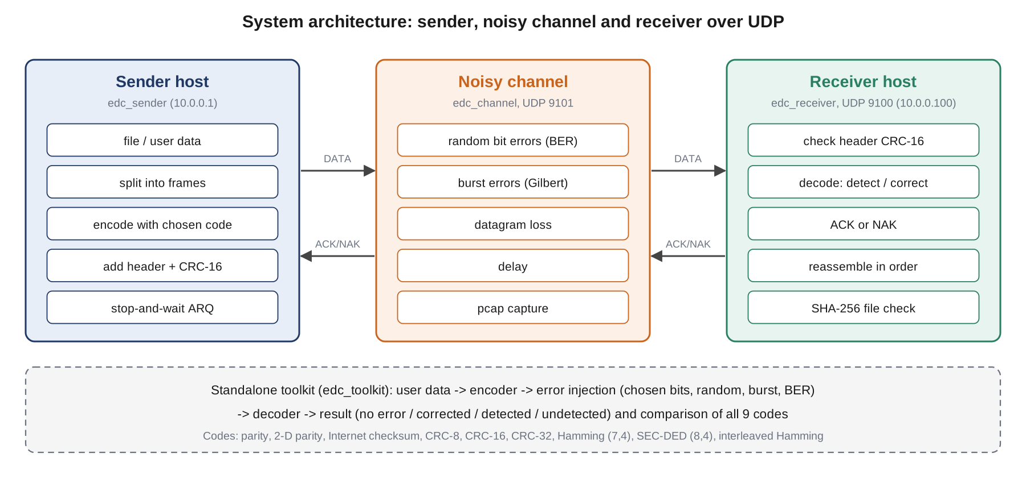
Proposed Design and Tools
Tools: C++17 (g++ / MinGW-w64), sockets API, Wireshark 4.2
Protocols: UDP, own 16-byte header with CRC-16, stop-and-wait ARQ
Addressing: 127.0.0.1 or LAN; channel UDP 9101, receiver UDP 9100
Computer Networks Laboratory CSE20110
45 seconds
Notes:
Suggested time: 45 seconds. The sender encodes each frame with the chosen code and sends it to the channel emulator, which flips bits (random or burst), drops and delays datagrams and writes a pcap file. The receiver decodes, corrects if it can, and answers ACK or NAK. UDP was chosen so that TCP does not hide the errors with its own checksum and retransmission.

Slide 4
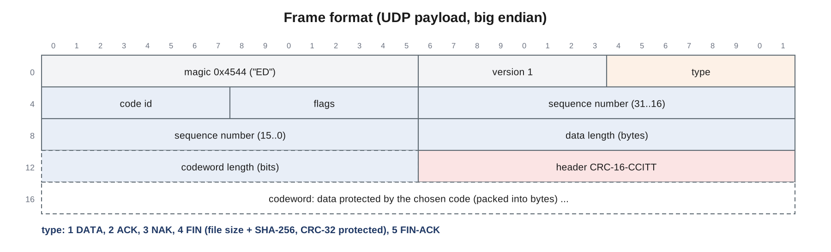
Implementation and Working
Implementation: codes, error models, frame + ARQ, channel, toolkit
Working: encode, channel flips bits, receiver corrects or sends NAK
Troubleshooting: CRC-8 missed some 2-bit errors beyond 127 bits; verified with a 72-bit test frame
Computer Networks Laboratory CSE20110
55 seconds
Notes:
Suggested time: 55 seconds. The frame header carries type, code, sequence number, data length and codeword length, protected by its own CRC-16. The FIN frame carries the SHA-256 of the file so the receiver can tell whether undetected errors reached the application. Issue found in testing: CRC-8 (x^8+x^2+x+1) cannot see two errors 127 bits apart, so it is only reliable on short frames; the test now uses a 72-bit frame and the limit is documented.

Slide 5
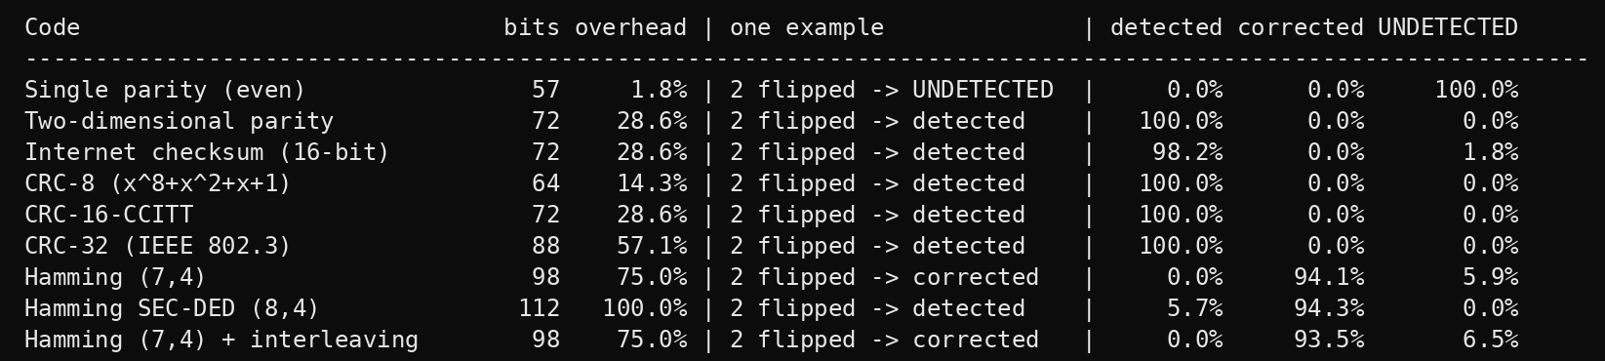
Testing and Results
Test: "NETWORK" with 2 random bit errors, 1000 trials per code
Expected: CRCs detect all; parity misses even error counts
Observed: parity 100 % undetected, CRCs 0 %; at BER 1e-3 SEC-DED file intact at 40.2 kbit/s vs 21.6 for CRC-32
Objectives achieved: 24/24 tests passed; O1 to O6 met
Computer Networks Laboratory CSE20110
50 seconds
Notes:
Suggested time: 50 seconds. The table is the real output of edc_toolkit compare. Single parity accepted every frame with two errors, the checksum missed 1.8 %, the CRCs missed none. Hamming (7,4) corrected 94 % because the two errors usually fall in different blocks. Over the network at BER 1e-3, SEC-DED delivered the file intact with almost twice the goodput of CRC-32 with retransmission. All 24 tests passed in 37 s.

Slide 6
Working Demonstration
Function to demonstrate
Detect and correct errors in typed data and in a file sent over noisy UDP
1. Start edc_receiver and edc_channel --ber 3e-4
2. edc_toolkit inject "HELLO" --flip 9, then edc_sender with crc32
3. Show NAK, retransmissions, SHA-256 check and frames in Wireshark
Success criterion: errors detected or corrected; received file identical
Computer Networks Laboratory CSE20110
65 seconds
Notes:
Suggested time: 65 seconds. Terminal 1: edc_receiver --port 9100 --out received.txt. Terminal 2: edc_channel --listen 9101 --server 127.0.0.1:9100 --ber 3e-4 --delay 1. Terminal 3: edc_toolkit inject --text "HELLO" --scheme hamming --flip 9 (corrected), then edc_sender sample_files/message.txt --port 9101 --scheme crc32 (NAKs, file identical) and --scheme parity (file corrupted). Open the capture with the edc_frame.lua dissector.

Slide 7
Conclusion and Contributions
Outcome: 9 codes, interactive toolkit, UDP transfer; 24/24 tests passed
Application: choosing a code and frame size for a noisy link
Limitation: errors are emulated; stop-and-wait is slow on long links
Future scope: hybrid ARQ (SEC-DED + CRC-32) with a sliding window
Team contributions: [Student 1]: codes, tests [Student 2]: toolkit, error models
[Student 3]: frames, ARQ, channel, Wireshark [Student 4]: experiments, report
AI use: Claude (Anthropic) helped draft code and text; all results come from our own runs
Computer Networks Laboratory CSE20110
30 seconds
Notes:
Suggested time: 30 seconds. CRC-16 and CRC-32 never accepted a wrong 64-byte frame; single parity and plain Hamming (7,4) delivered corrupted files at BER 1e-3; correction pays off at moderate error rates only when the code can also detect its own failures (SEC-DED). Replace the bracketed names with the real members and their actual work.

Slide 8
References
[1] R. Braden, D. Borman, C. Partridge, "Computing the Internet Checksum," RFC 1071, 1988.
[2] W. W. Peterson, D. T. Brown, "Cyclic codes for error detection," Proc. IRE, 1961.
[3] R. W. Hamming, "Error detecting and error correcting codes," Bell Syst. Tech. J., 1950.
[4] A. S. Tanenbaum et al., Computer Networks, 6th ed., Pearson, 2021.
Use IEEE-style numbered references and cite sources on relevant slides.
Computer Networks Laboratory CSE20110
Backup slide
Notes:
Backup slide. Full reference list (nine entries) is in the project report.

